Slide 1
Intruder Detection System
Muhammad Izham Bin Norhamadi
Ahmad Sha Herizam Bin Tahir
Affendy Elyas Bin Azhari Sharidan
Nur Ilyana Syahirah Binti Mohamad Azhar
Muhammad Rifqi Bin Ramlan
Muhammad Ikmal Bin Mazlan

Slide 2
Introduction
There are security concerns and the need for surveillance systems in today modern lifestyles
The proposed solution and goal of this project is an intruder alarm system using Raspberry Pi, which is a low-cost and easily implemented option for providing additional security system
The system uses motion detection and can notify the owner through a channel (like Telegram) when the sensor is activated
The focus of this project is on low-cost technology that can be implemented without a large capital investment, but still has the ability to automatically notify occupants in the event of an intruder detection.
Notes:
- More valuables and places to safeguard

Slide 3
Problem Statement
There is a need for additional security on entrances, but it can be costly and difficult to set up a detection system on every entrance
Some detection systems are expensive, require a lot of effort to set up, and may have niche hardware that limits flexibility in installation
Some company that provide the intruder detection system only provide proprietary hardware. It has been created and coded to appropriately interact with their systems

Slide 4
Tools
Raspberry pi
A small single-board computers
Breadboard
A breadboard is used for building circuits
Python 3
Programming language used to control the flow of the project
Node-RED
A visual programming developed originally by IBM for wiring together hardware devices
Motion sensor – Infrared Sensor
IR stands for Infra-Red. These sensors are basically a pair of IR transceivers LEDs. Which emit and receive IR light for detection of any object in front of them. Will be used to detect any motion in its surrounding
Buzzer
Can be used as indicator when the motion sensor detect something. It will create a buzzing sound.
Jumper Wire
To connect electronic part between the breadboard and raspberry pi

Slide 5
Modules
1) Intrusion Module
Motion detector placed behind doorway and when this sensor activates the following sequence happens:-
Activates buzzer to warn the occupants
Notify owner through update channel (such as Telegram)
2) Disarm alarm Module
Giving user option to disarm alarm or turn off activated alarm

Slide 6
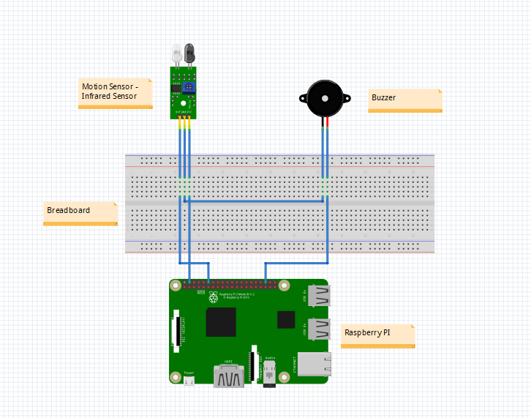
Solution Diagram

Slide 7
DEMO

